Slide 1



Economic Cycles in the U.S. (1980–2025)
ITC 300: Data Visualisation Final Project
Presented by: Mohammad Mustafa Hakimi
Student ID: 48704
Professor: Dr. Ahmed Alijanad
Date: May 15, 2024
Notes:
1

Slide 2

Introduction
Economic Cycles in the U.S. (1980–2025)• Two market crashes, two bubbles, one pandemic
• Extreme shifts in inflation, unemployment, and interest rates
• Federal Reserve interventions shaped market outcomes
• Gen Z and digital investors now feel these effects directly
• Question: Is today’s economy worse than past periods?
Notes:
2

Slide 3
Scope, Data & Methodology
Analysis Framework
Measurement Approach
• Time span: 1981–2025
• Data sources: Federal Reserve + Kaggle presidential dataset
• Metrics analyzed:
• Unemployment
• Interest rates
• Market volatility (VIX)
• Inflation (YoY CPI)
• Line charts:
• Long-term trends (1981–2025)
• Presidential terms highlighted by color
• Bar charts:
• Compare mean & standard deviation across presidencies
• Methods:
• Groupby, apply, aggregate
• Reusable plotting functions per metric
Notes:
3

Slide 4

Unemployment Trends Across Presidencies
7.5%
14.8%
4.3%
Highest Averages
COVID Peak
Second Term Start
Obama & Reagan faced elevated unemployment throughout their terms
Trump's first term hit this unprecedented high in April 2020
Trump's early 2025 average—too preliminary for analysis
Notes:
4

Slide 5
Interest Rates & Monetary Policy Evolution
Reagan Era
Trump First Term
Highest average rates at ~9.6% as Fed fought inflation aggressively
Moderate increases with controlled volatility pre-pandemic
1
2
3
4
Obama Years
Biden Administration
Lowest and most stable rates following 2008 crisis recovery policy
Rising rates as Fed responds to post-COVID inflation pressures
Notes:
5

Slide 6

Market Volatility: The VIX Story
George W. Bush
Bill Clinton
Highest volatility during 2008 financial crisis and dot-com collapse
Lowest volatility during tech boom and stable growth period
Trump & Beyond
Low first term until COVID; second term shows preliminary stability
Notes:
6

Slide 7
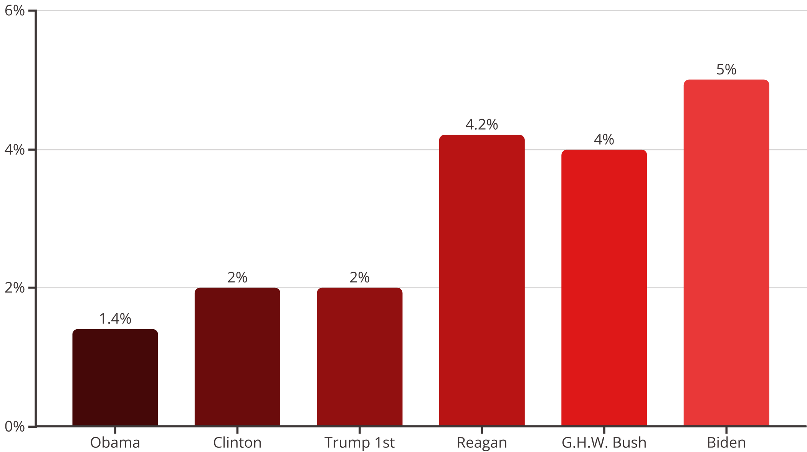
Inflation Patterns: Four Decades of Price Changes
Notes:
7

Slide 8

Key Takeaways
Context Shapes Outcomes
Methodology Matters
Early Data Limitations
Global Implications
Notes:
8

Slide 9

Thank You & References
We appreciate your time and attention to this analysis of U.S. economic cycles. We hope these insights provide valuable context for understanding past trends and anticipating future developments.
Data Sources & Further Reading
Federal Reserve Economic Data (FRED): fred.stlouisfed.org
Kaggle Datasets (Various Economic Indicators): kaggle.com
U.S. Bureau of Labor Statistics (BLS): bls.gov
U.S. Census Bureau: census.gov
Congressional Research Service (CRS) Reports
Notes:
9

